Slide 1


Slide 2
A high-level look at asynchrony in Redux
Async
1. Dispatch
action
2. Call API
3. Get Response
Components
Redux
store
API
4. Store Data
4. Store Error
5. Render

Slide 3
Redux-thunk
(action) =>
Action creator function
Called by component
Return
(dispatch, getState) =>
Used to dispatch down-stream actions
Used to acces the current state of the store
A thunk which gets called by middleware

Slide 4
DEMO
Redux-thunk by example

Slide 5
Redux Observable
Another middleware option that allows you to handle asynchronous logic.

Slide 6
+
=

Slide 7
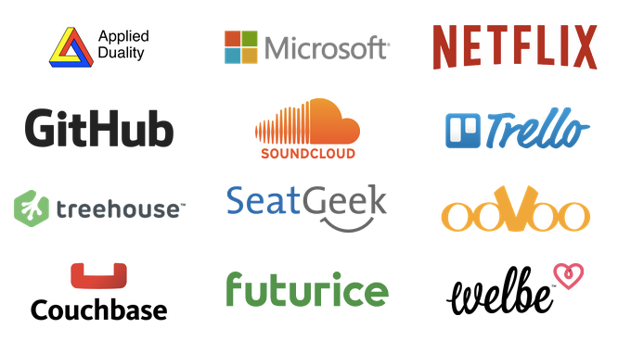
RxJS

Slide 8
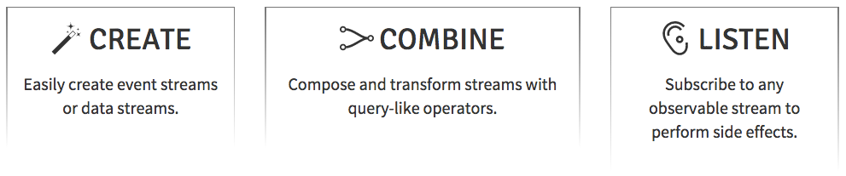
RxJS

Slide 9
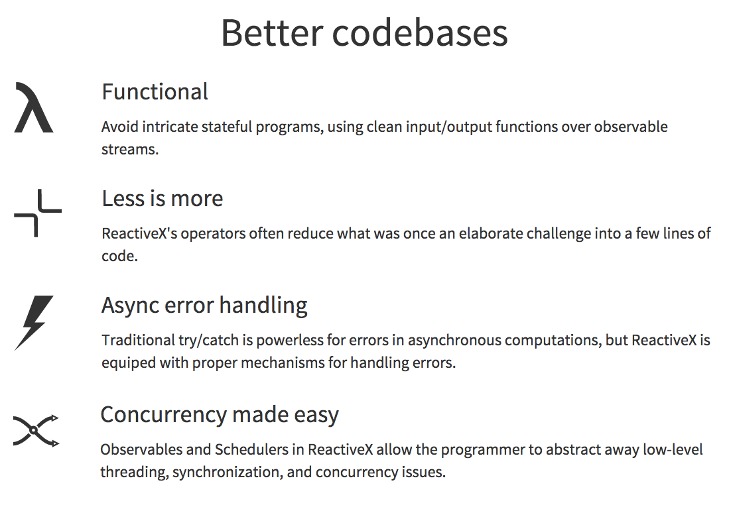
RxJS

Slide 10
RxJS: Observables
Observable
Flip
X
Subscriber

Slide 11
RxJS: Create Observables
of('hello')
from([1, 2, 3, 4])
interval(1000)
ajax('http://example.com')
webSocket('ws://echo.websocket.com')
fromEvent(button, ‘click')
many more...

Slide 12
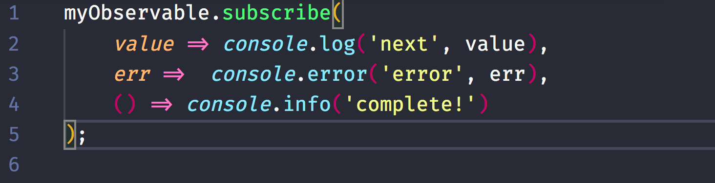
RxJS: Subscribe an Observable

Slide 13
EPICS
INPUT: Action over time in an Observable
OUTPUT: Downstream actions in an Observable
A function that takes a stream of all actions dispatched
and returns a stream of new actions to dispatch
Jay Phelp, Netflix

Slide 14
DEMO
Use EPICs in Redux

Slide 15
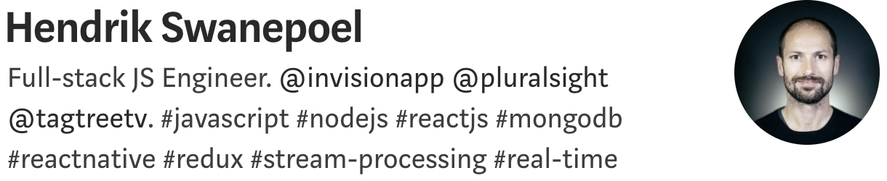
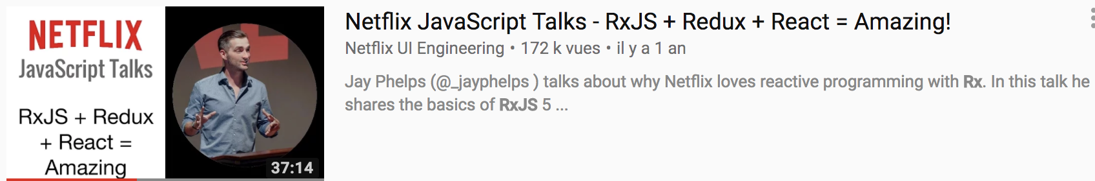

Slide 16
MERCI !

